Slide 1
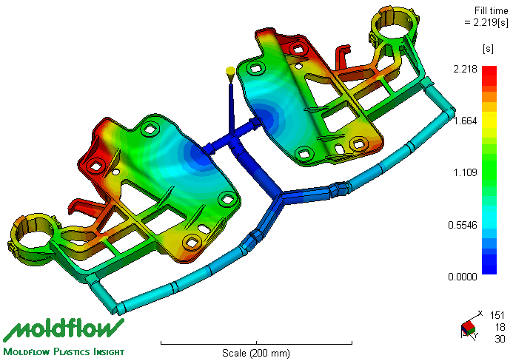

Polymer Basic Training
Seminar 2
CATS Calculation & Design Tools
Presenter
Application Development Automotive
Date

Slide 2
Content
What can we do for customer?
Concept design
Design optimization
Moldflow calculation
FEM calculation
High efficient cooperation?

Slide 3
CAE Software Portfolios
Modelling (CAD)
NX-IDEAS
NX9.0
CATIA V4 & V5
Finite Element Analysis (FEA)
IDEAS
NX NASTRAN
ANSYS
ABAQUS
Moldflow
Autodesk Moldflow Insight
Mesh Tool
Hypermesh
Topology & Shape Optimization
TOSCA
Material Simulation
DIGIMAT
Fatigue
FEMFAT
Crash
LS-DYNA
*Softwares marked by blue can only be supported by ADC Switzerland currently.

Slide 4
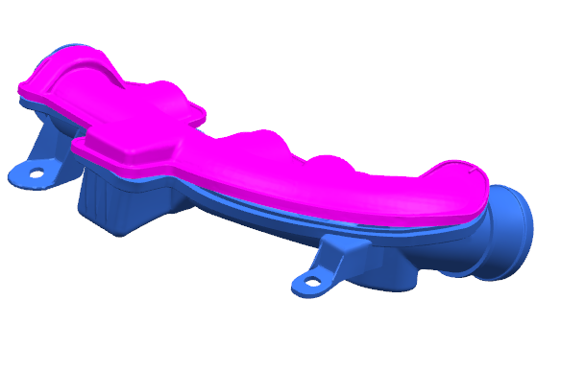
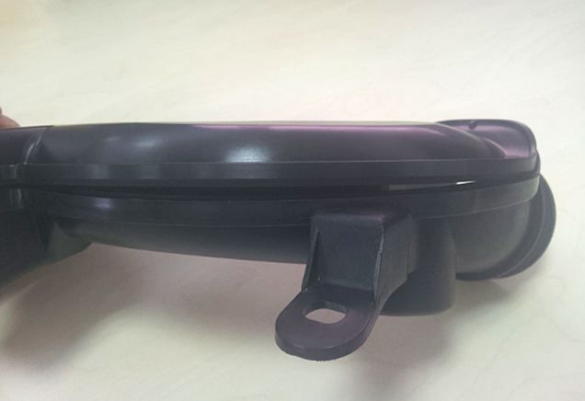
Moldflow Support: Warpage Prediction
Simulation VS molding trial results
Calculated gap between two parts
Gap between two injected parts

Slide 5
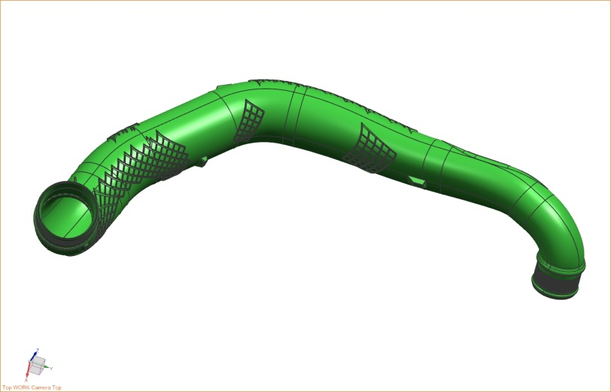
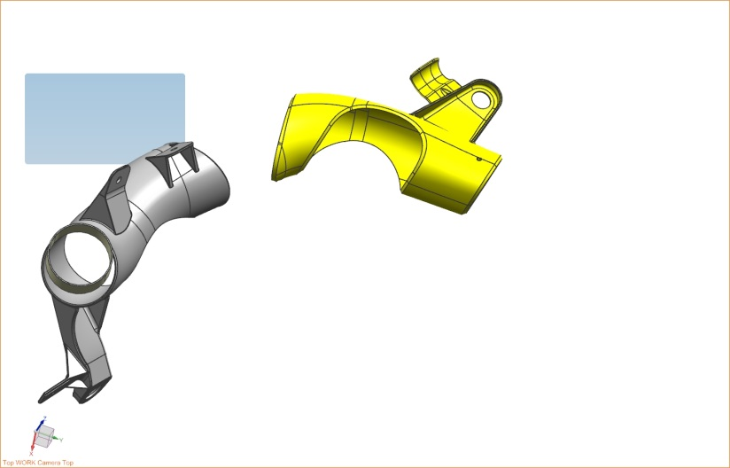
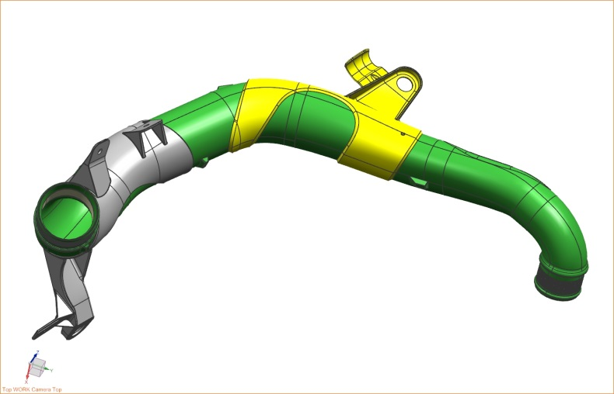
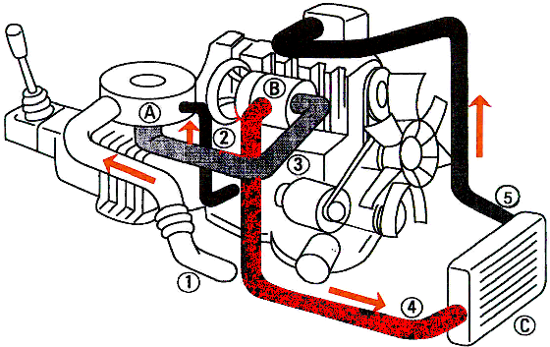
Moldflow Support: Gating System Optimization
EMS solution:
Material: Tube Grilon EBGM-20H
Bracket Grilon BG-15 FC
3D blow molding
Overmouldling

Slide 6
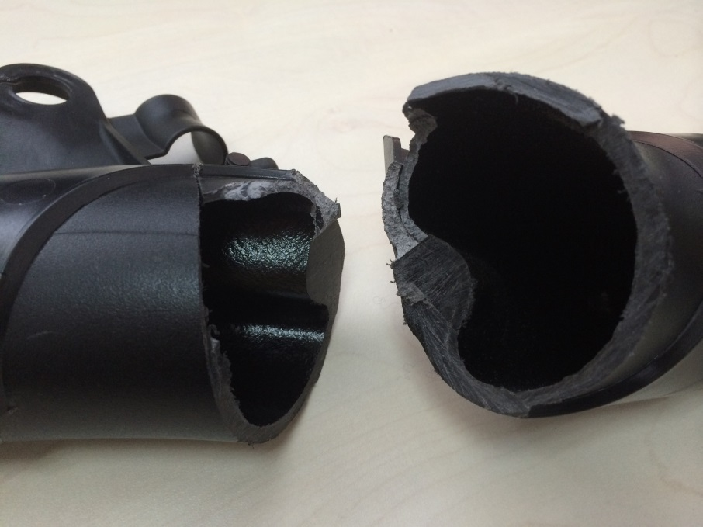
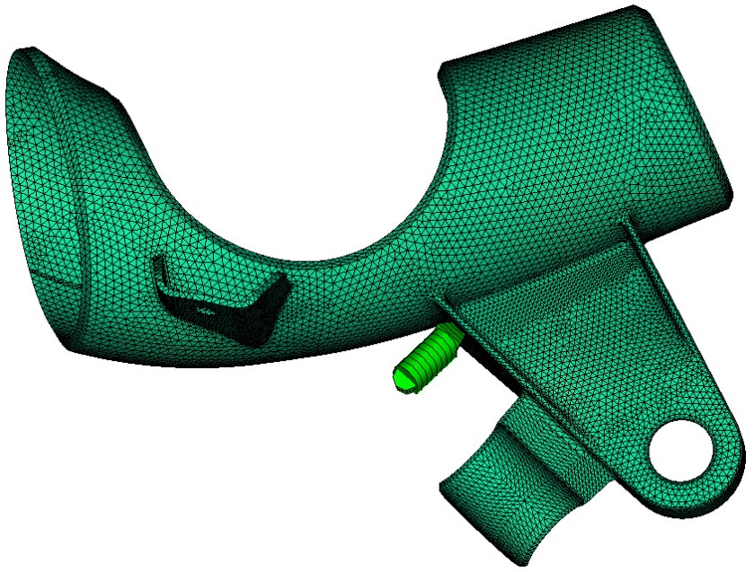
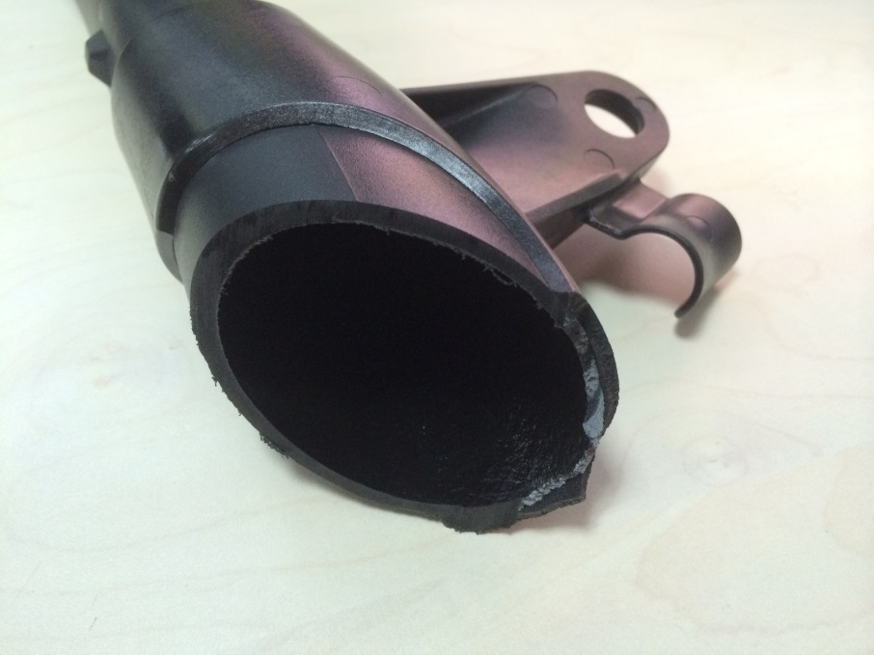
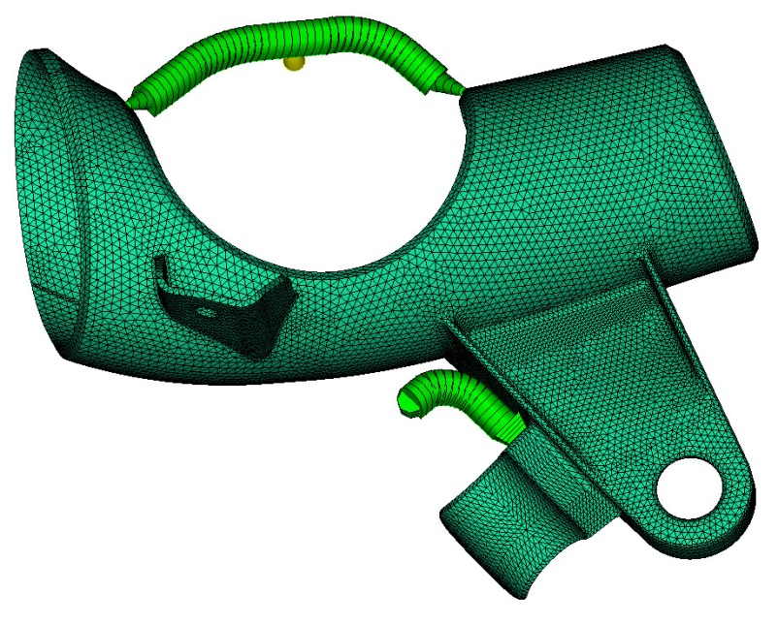
Moldflow Support: Gating System Optimization
Original gate
The tube is remelted during overmouldling.
Optimized gate
By optimizing gating system and process, problems have been solved!

Slide 7
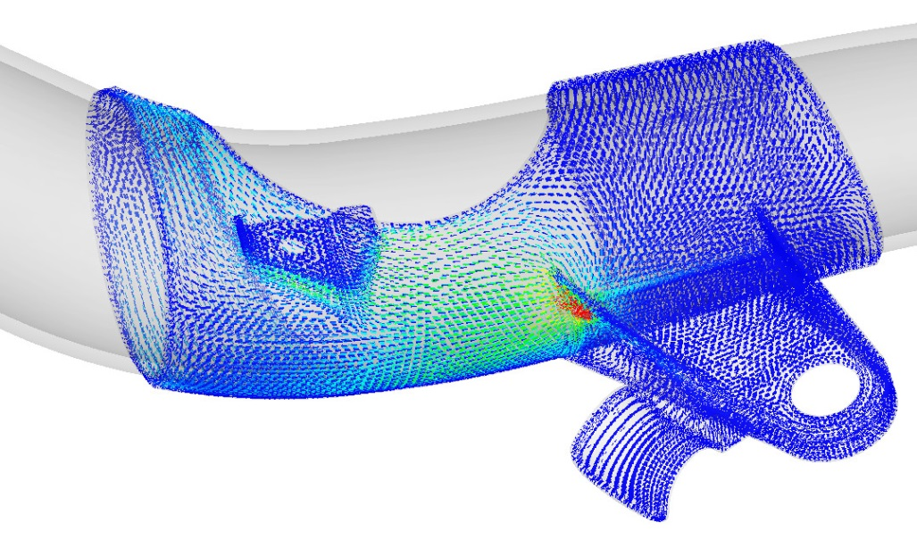
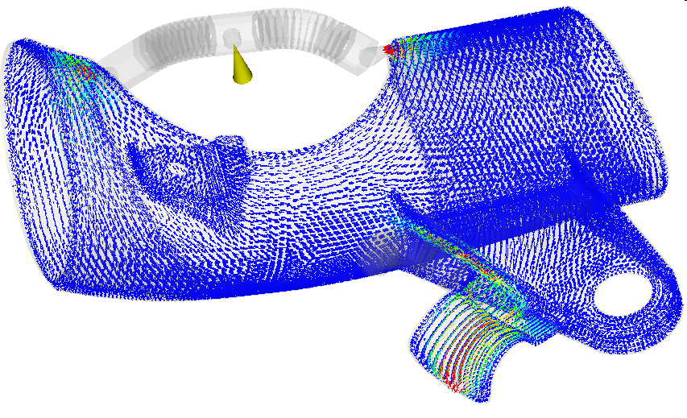
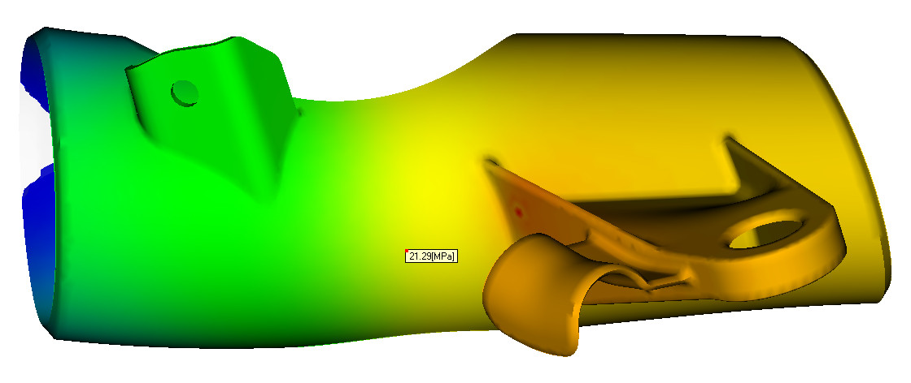
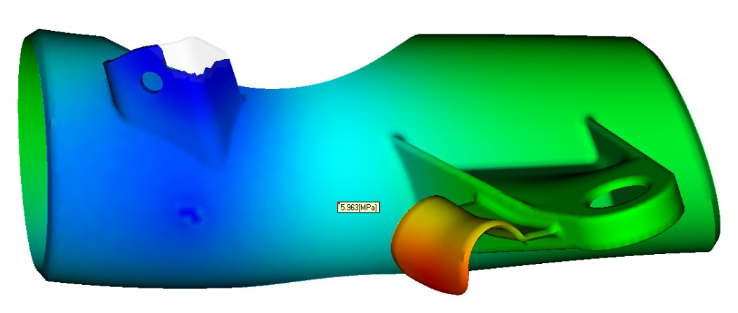
Moldflow Support: Gating System Optimization
Original gate
By using more gate
Melt velocity decrease around 30%
Injection pressure decrease to 20%

Slide 8
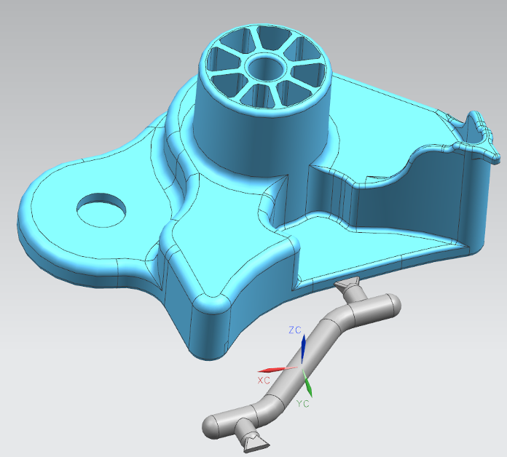
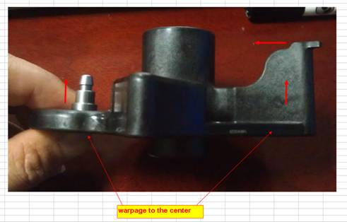
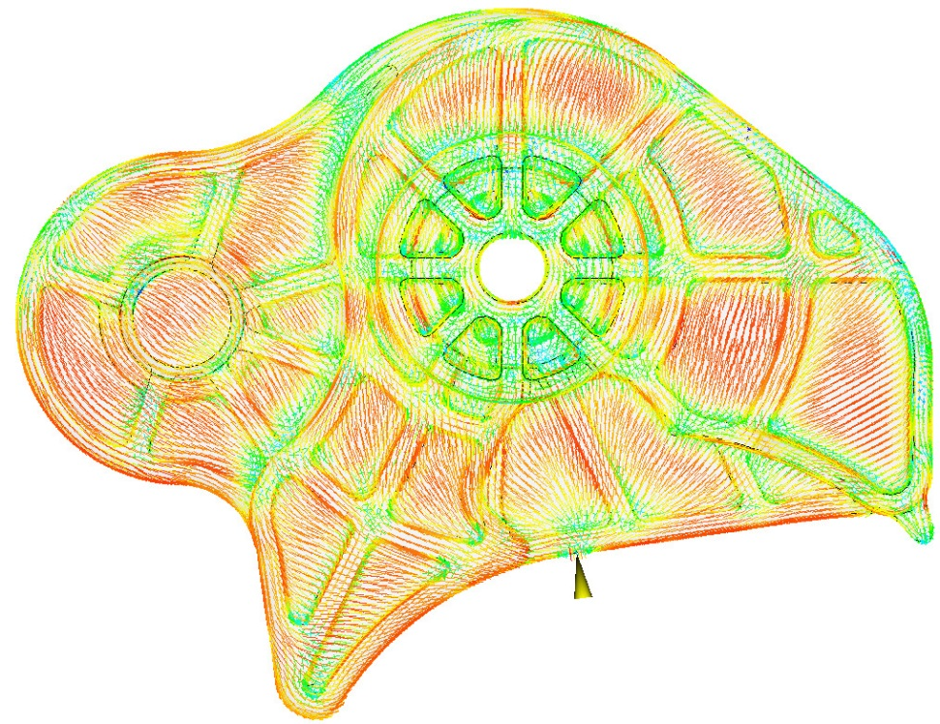
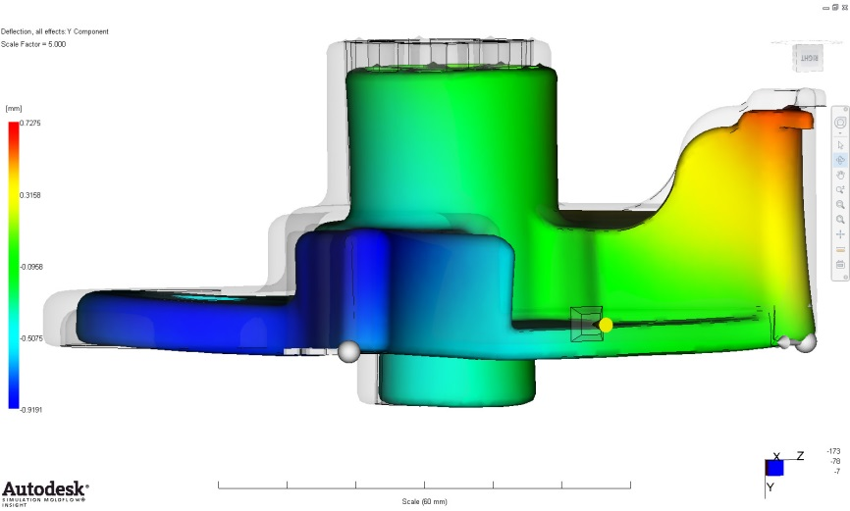
Moldflow Support: Warpage Optimization
Fiber orientation
large Shrinkage
Large Shrinkage

Slide 9
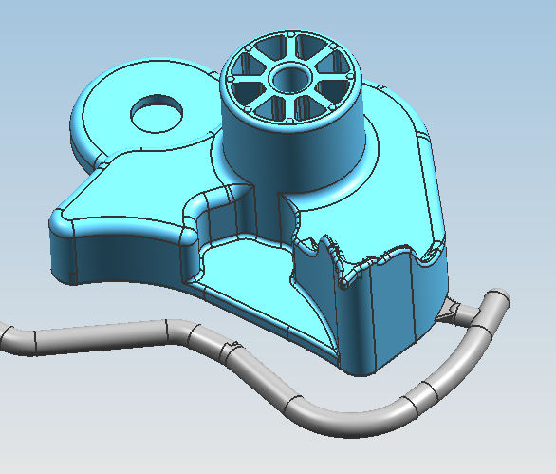
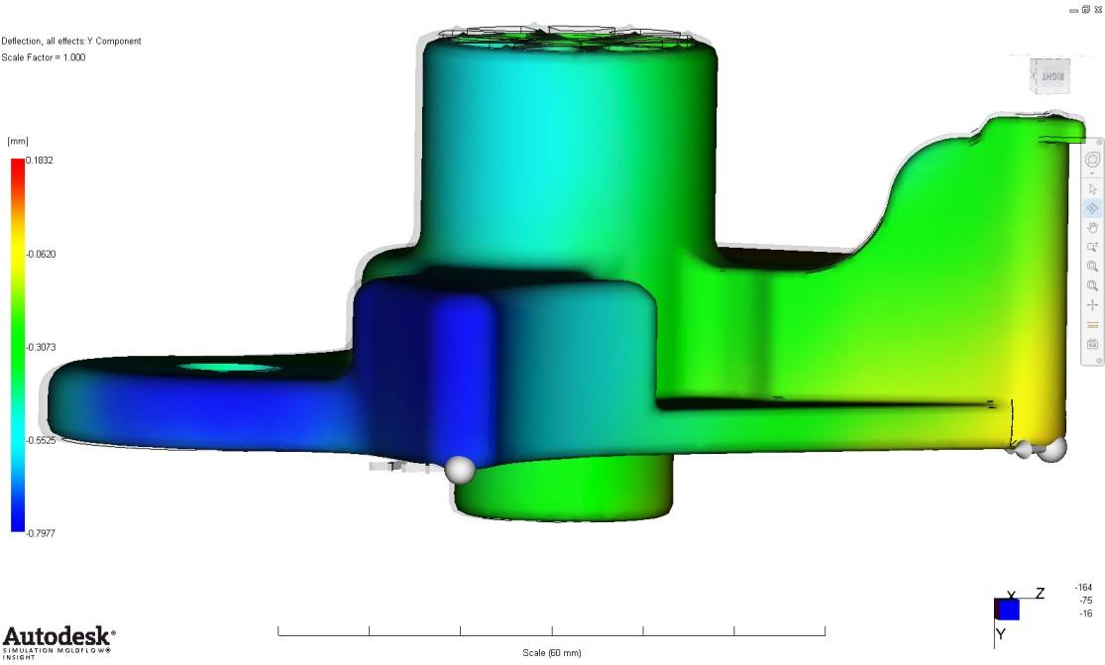
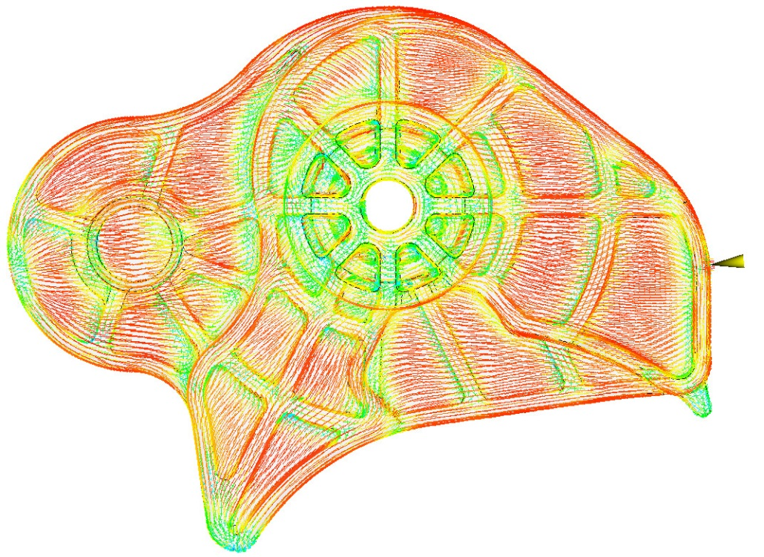
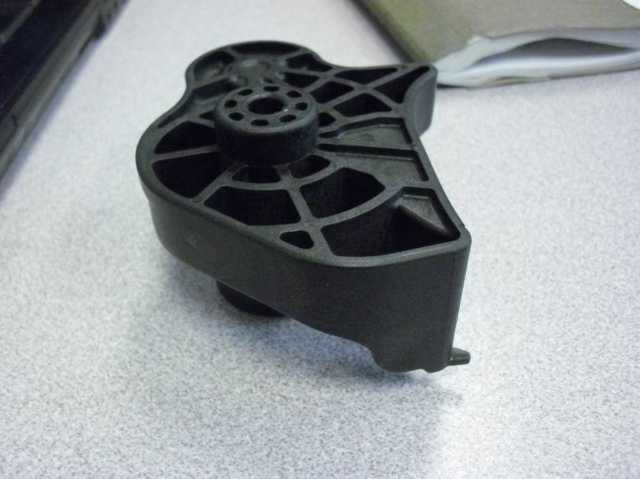
Moldflow Support: Warpage Optimization
Fiber orientation
Small Shrinkage
Small Shrinkage
Warpage reduced to 1/3 compared to original gate position

Slide 10
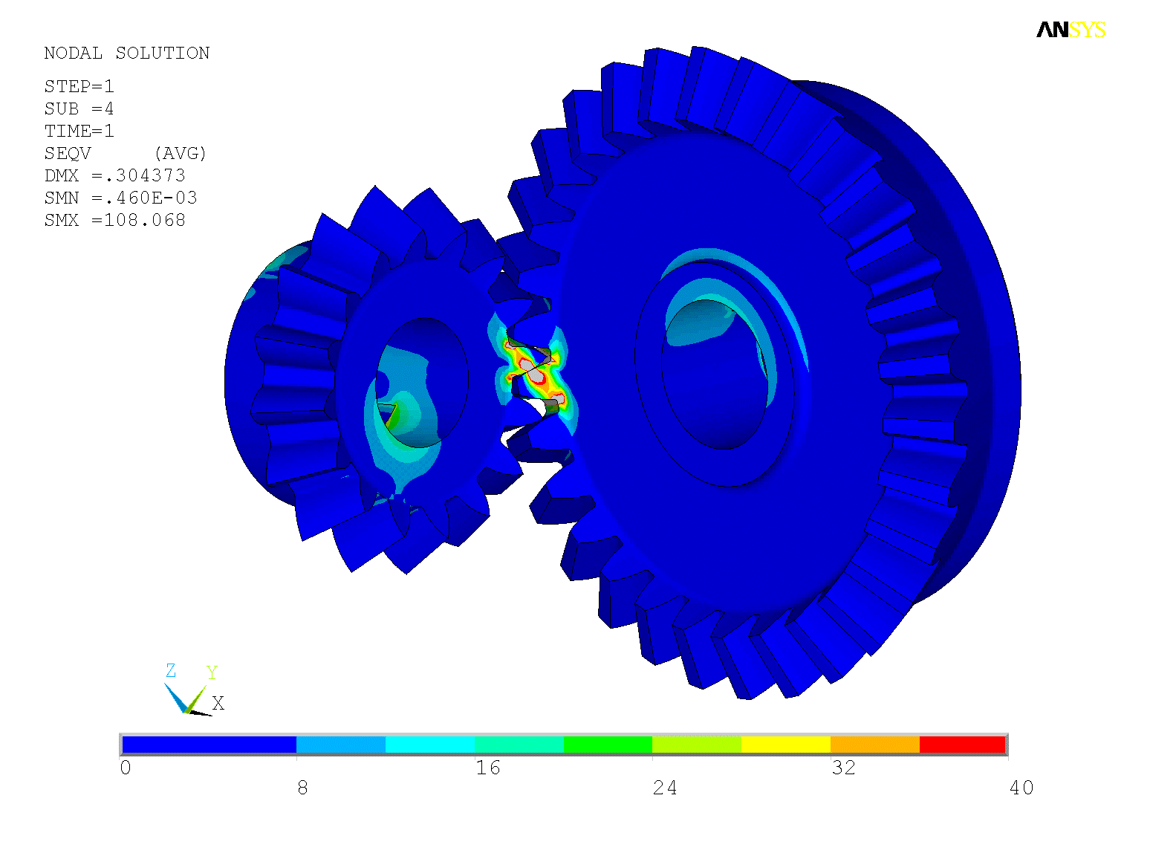
FEM Analysis: Gear Mesh Stress Calculation
Grivory GVX-65H
Equivalent stress

Slide 11
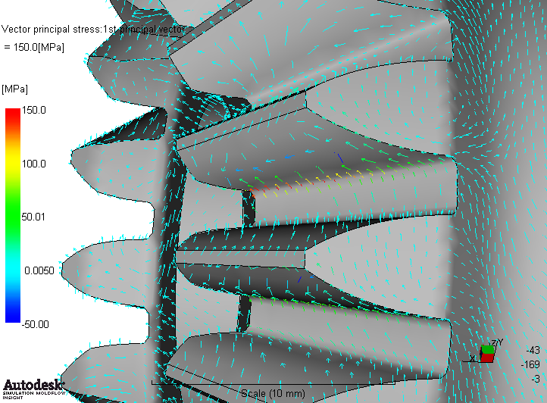
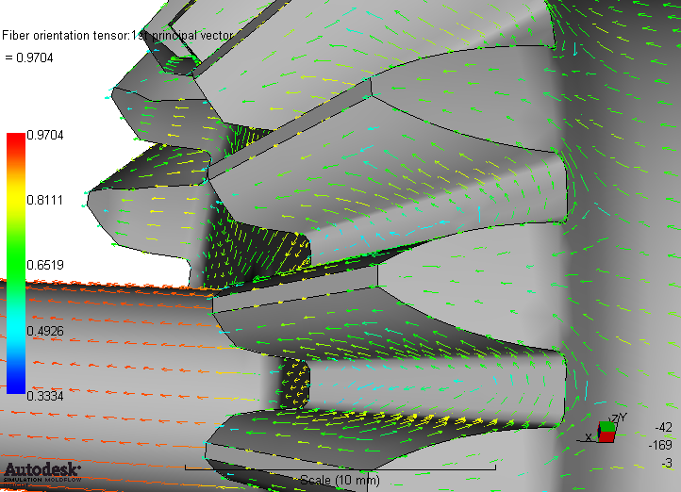
FEM Analysis: Gear Mesh Stress Calculation
1. principal stress
2. principal fibre orientation
FEA
rheology
Principal stress can be viewed in Moldflow through second development using VB

Slide 12
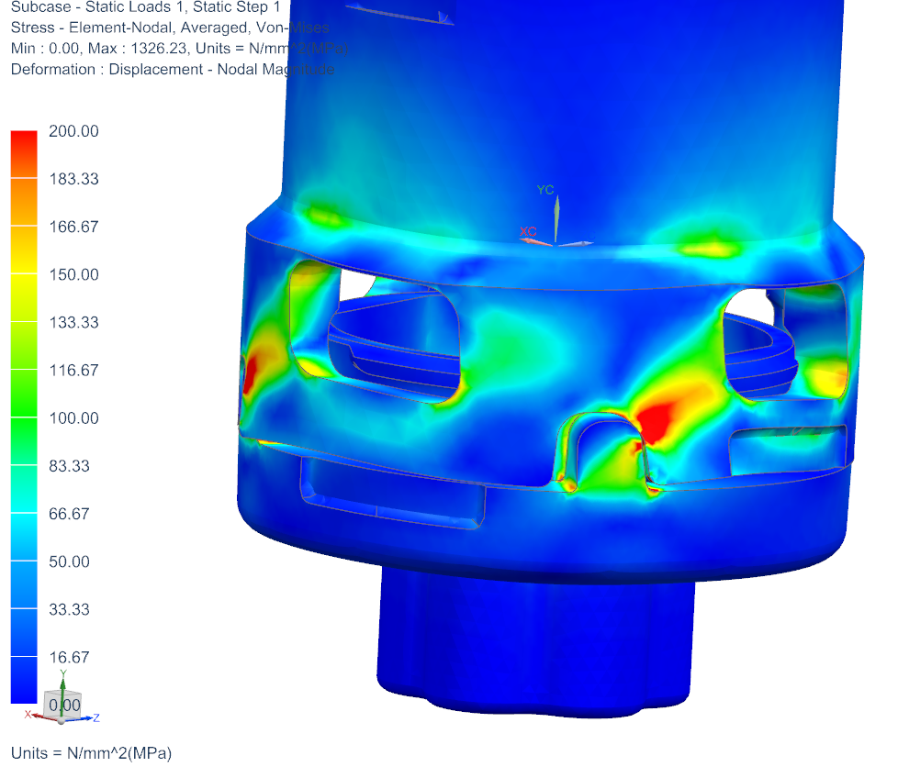
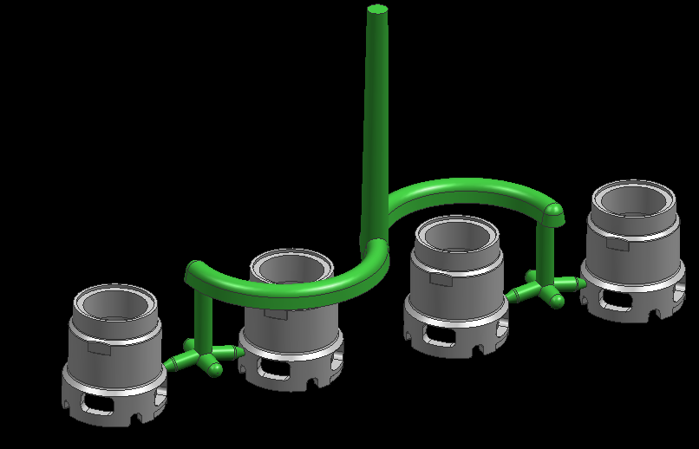
Water Tap Breakage Analysis
Stress plot
Runner System

Slide 13
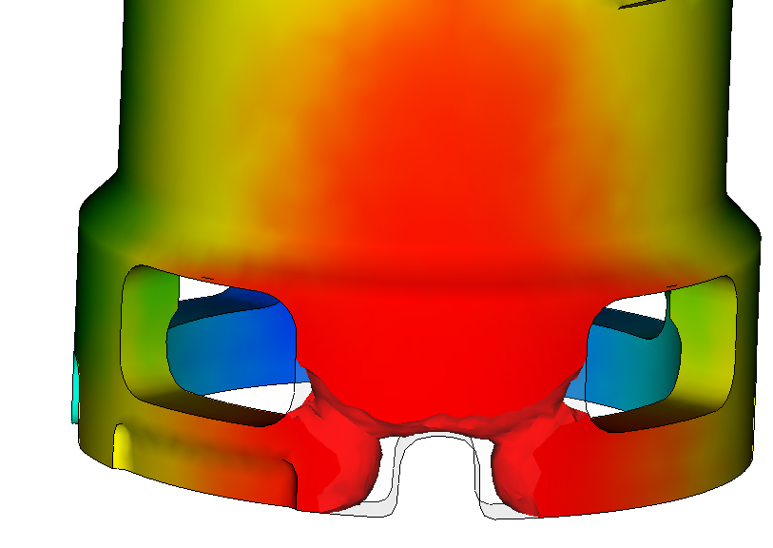
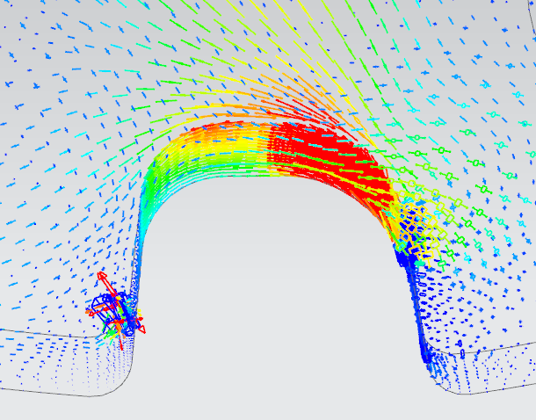
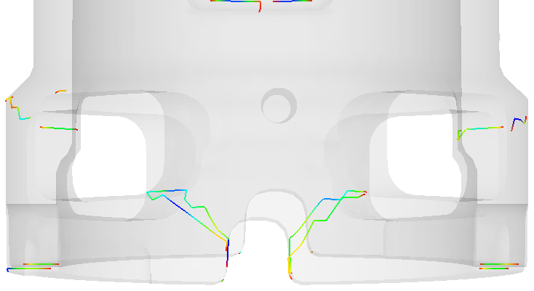
Water Tap Breakage Analysis
Principal stress
Principal stress is perpendicular to the weldline, breakage will happen under high torque.
Weldline

Slide 14
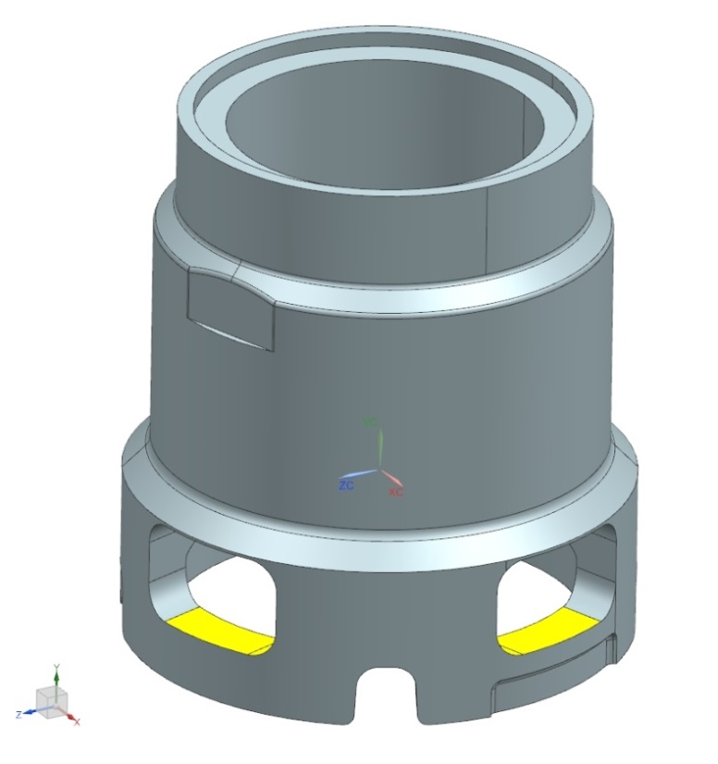
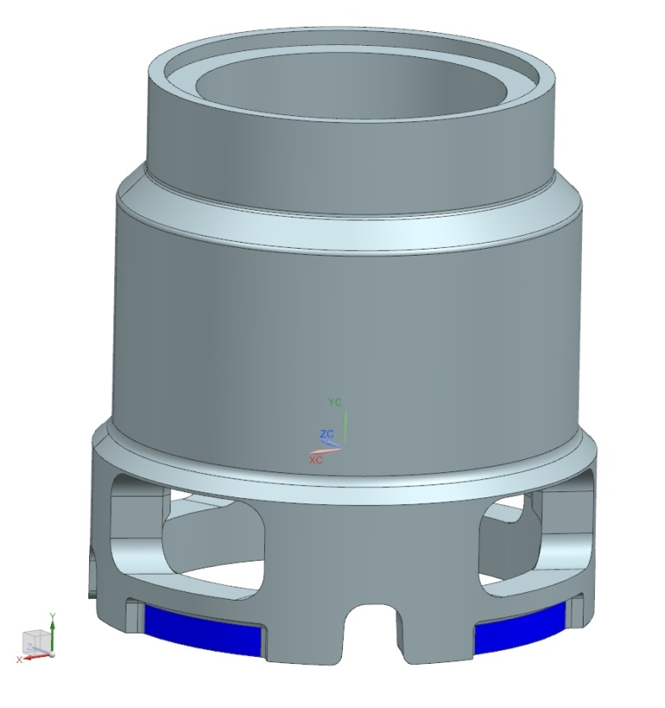
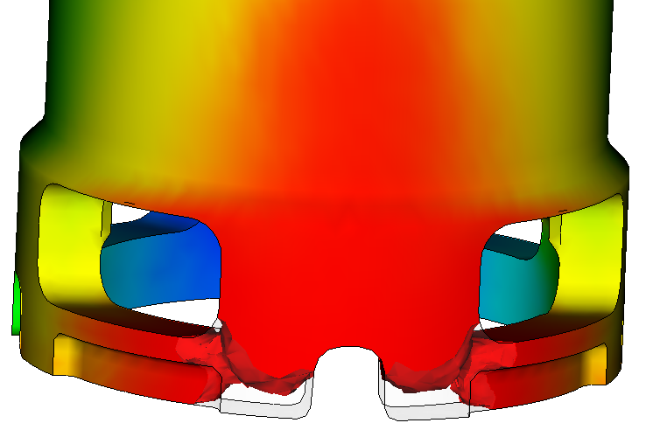
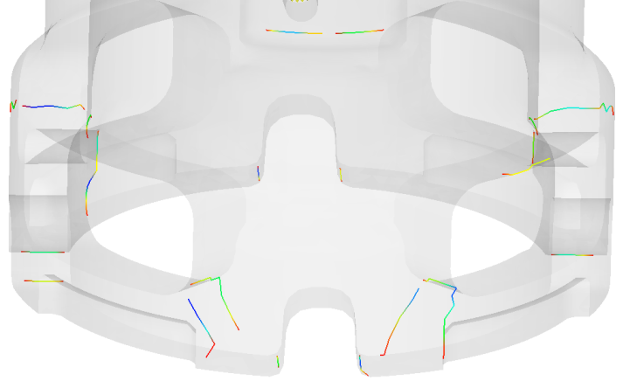
Water Tap Breakage Analysis
Create 0.25mm deeper slots as flow brake.
High stress
Original design
Recommended design
Weldline were shifted to low stress areas and the part can pass the torque test!

Slide 15
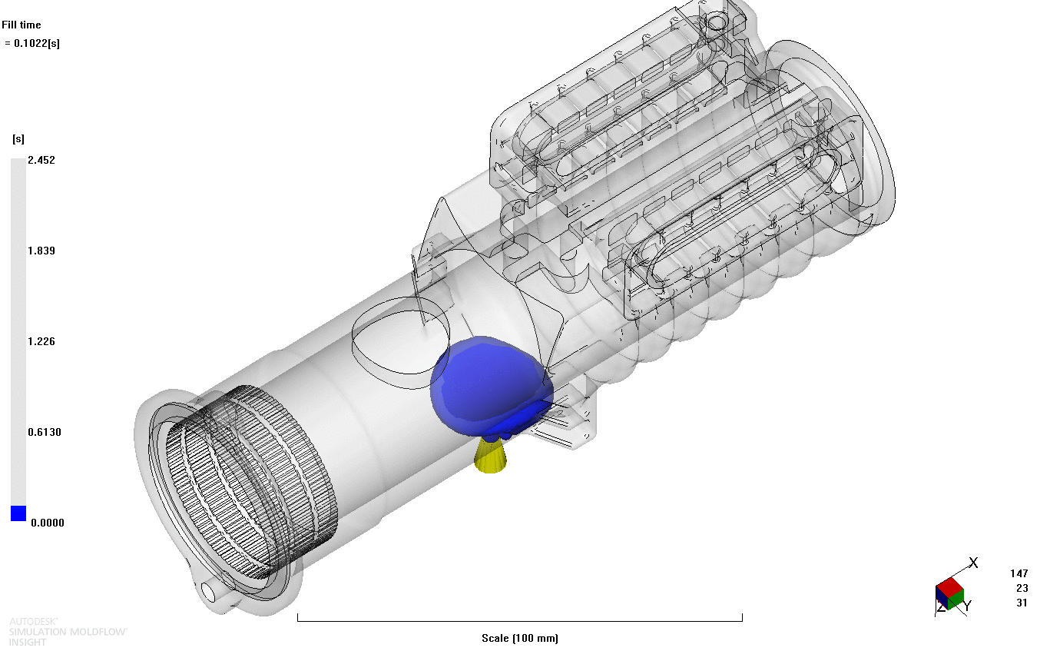
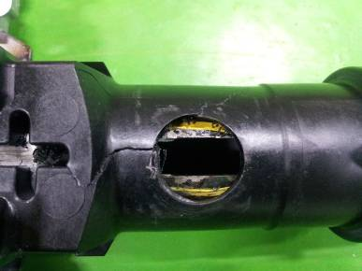
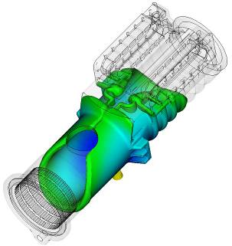
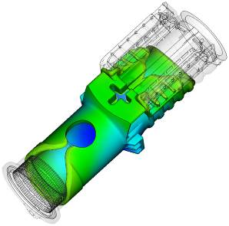
MFA+FEM : Using Metal Insert if Necessary
Breakage occurred at the weldline!

Slide 16
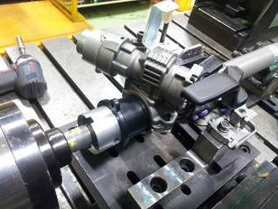
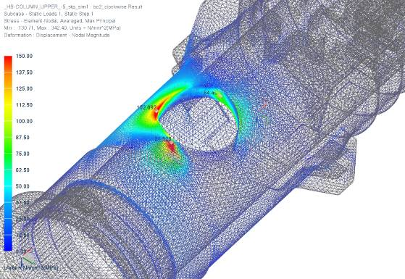
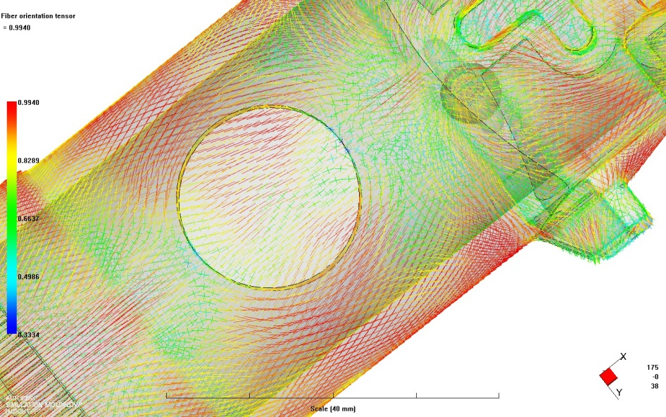
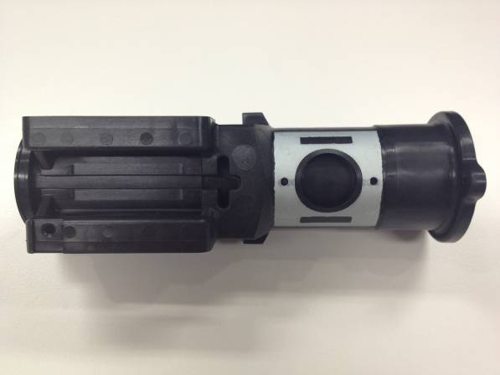
MFA+FEM : Using Metal Insert if Necessary
84MPa
152MPa
95MPa
The redesigned part fulfills test requirements.

Slide 17
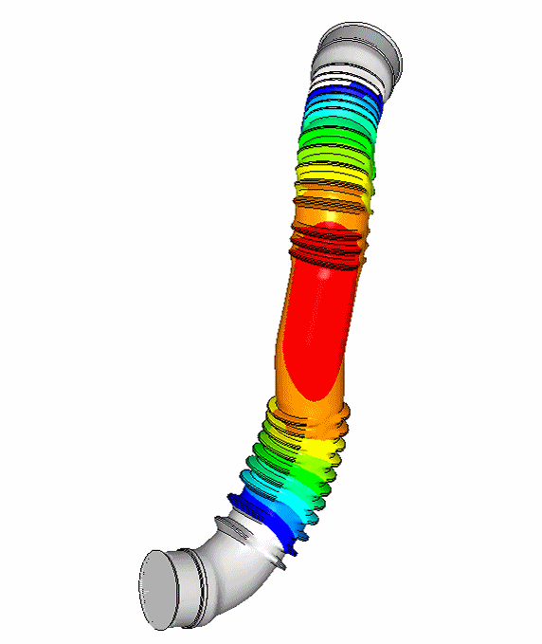
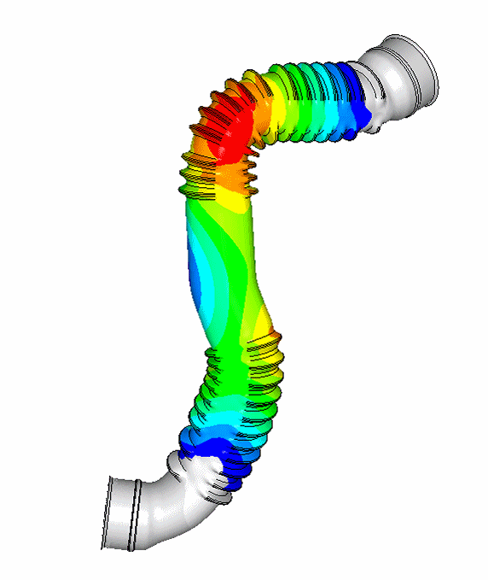
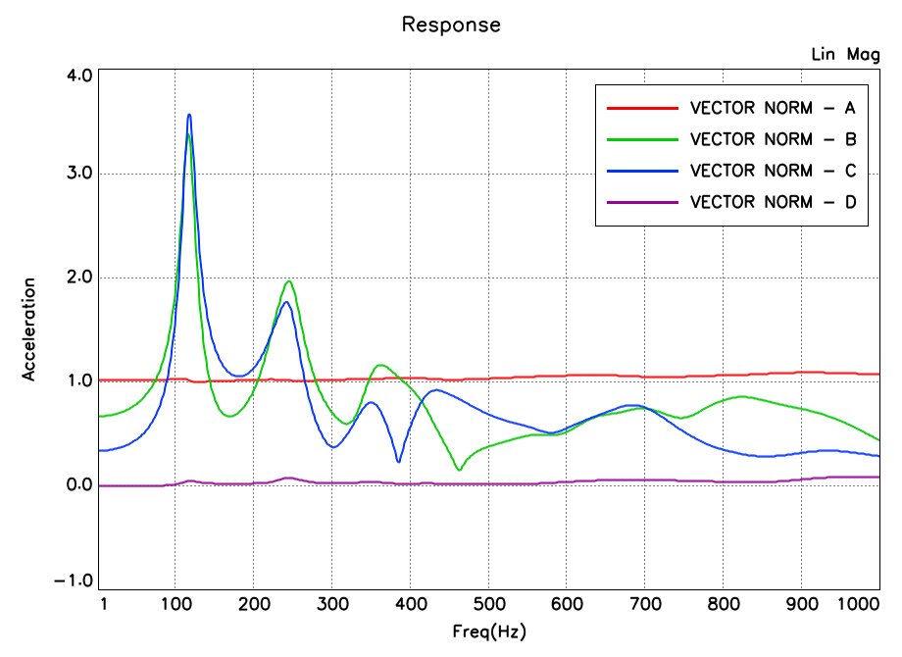
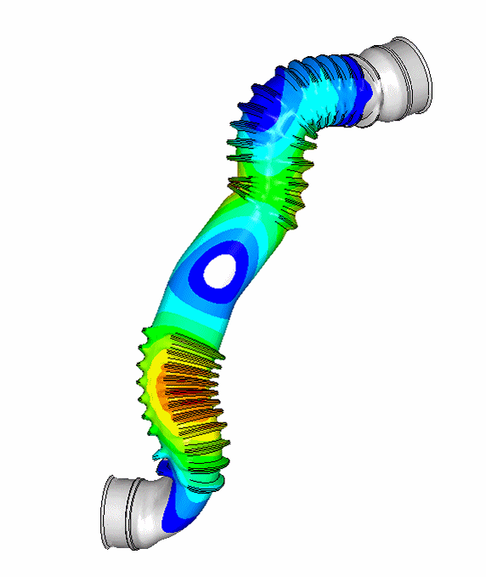
Vibration Analysis of Air Duct
Normal mode results at peak of A,B,C,D
Mode1 : 117Hz
Mode3 : 233Hz
Mode5 : 350Hz

Slide 18
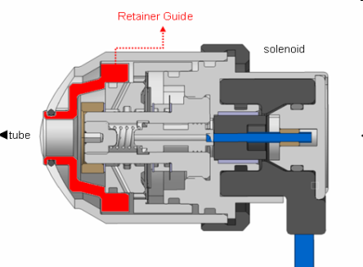
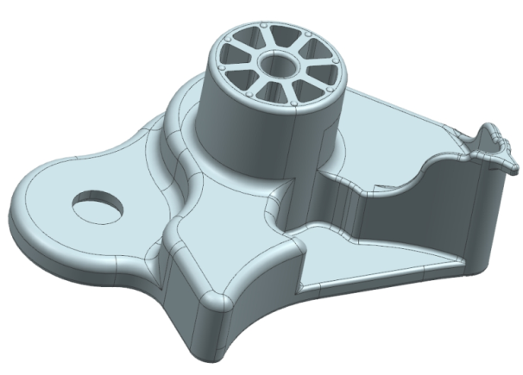
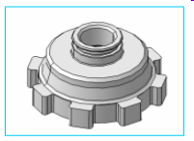



What Do We Need?
CAD File (*.stp, UG file, Checklist, Objective)
How the part works? (principle, loading)
Test conditions and test results
CAE report done by customer for reference

Slide 19

Cost Estimation Calculation
Before you submit the request, please think below questions ahead:
Cost estimation calculation needs to be done firstly
Application:
Clutch Master Cylinder (CMC) Housing
New Design or Metal Replacement:
Metal Replacement

Slide 20
Cost Estimation Calculation Sample
Current Solution: Al Die-Cast
Weight of Metal Part: CNY 17.80
Cost of Metal Part: 223 g
Potential: 20,000 pcs/a
Customer Part Nr.: T22 041 021
Material for Calculation: Grilon TSG-35/4 W2
Black 9839

Slide 21
Cost Estimation Calculation Sample
 | Favorable | Unfavorable
Injection Molding Cost per Part [CNY] | 11.79 | 14.29
Die Cast Cost per Part [CNY] | 17.80 | 17.80
Cost Savings [%] | 34 | 20
Weight Savings [%] | 43 | 38
Note: the recommendations and data given are based on our experience to date, however, no liability can be assumed in connection with their usage and processing.

Slide 22
Cost Estimation Calculation Sample
14.29 CNY
The cost difference is: 17%

Slide 23
The Earlier, The Better
Virtual Prototyping (CAE) = High Leverage
CAE as a problem solver
= Lower leverage
100%
Cost
Influence Potential
Cost
Generation Potential
0%
Product
Definition
Product Conception
Product Development
Production

Slide 24





FEM Analysis: Piston Breakage Analysis
Add ribs
Original design
Directly replace aluminum with plastic, stress level is higher than allowable strength for selected material.
200MPa!
Optimized design

Slide 25



FEM Analysis: Piston Breakage Analysis
Without consideration of fiber orientation
78MPa
Considering fiber orientation
90MPa
Fatigue strength at 1M cycles is 80MPa.

Slide 26


FEM Analysis: Piston Breakage Analysis
Test condition
Real load condition
Difference between S-N curve test and load condition in reality, mean stress influence.
The optimized part can pass the life test!
Why?

Slide 27


Project Workflow : Steering Lock Housing
Metal replacement project
The part must pass the 300N.m torque test.
Critical areas
Zinc die casting weight: 450g
Using GV grade material plus metal insert: 150g

Slide 28

Project Workflow : Steering Lock Housing
210 MPa
0 MPa
FEM analysis to check the feasibility of replacement

Slide 29




Project Workflow : Steering Lock Housing
Good agreement between simulation and prototype test results.

Slide 30

Project Workflow : Steering Lock Housing

Slide 31

Project Workflow : Steering Lock Housing
Metal insert solution to compensate the strength of the part

Slide 32
Disclaimer
The information contained in this publication is based on our present know-ledge and experience. The given figures and data are guidance values and do not represent binding material specifications. No warranties of any kind, either express or implied, including warranties of merchantability or fitness for a particular purpose, are given regarding products, design, data and information. The customer is not released from his obligation to investigate the products fitness and the suitability for the intended application, compliance with legal requirements and intellectual property rights. We reserve the right to change the information at any time and without prior notice. The information in this publication is not to be considered a contractual obligation and any liability whatsoever is expressly declined. For further questions about our products please contact our experts.

